Slide 1
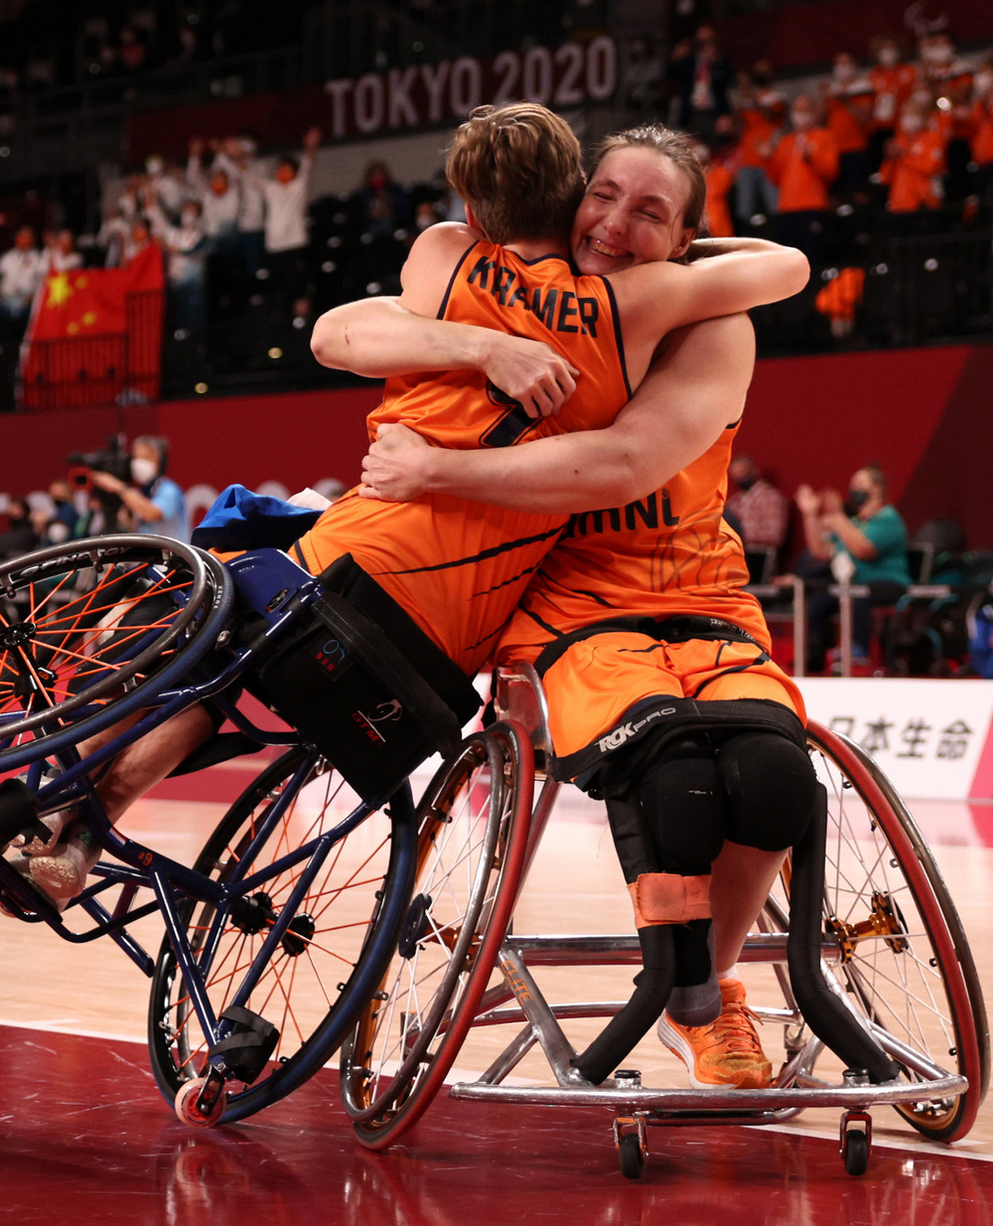
OPEN PRESENTATION
PROJECT WHEELS
Created by: Jake van der Valk, Martijn Kok,
Alejandro Oliver Llorente, Collin van Adrichem, Daan Gielen
Notes:
Good afternoon, everyone, we are Daan and Collin of the project wheels and with this external presentation we want to give you an insight into the progress we have made and what our plans or going further.

Slide 2
TABLE OF CONTENTS
Recap of the last presentation
Brief introduction
Project activities
The present
neural networks
repeat modelling
Whats next
Notes:
Since last month was the last presentation we will give a brief overview of our project and what we presented last time.
furthermore we will talk about the progress we have made over the last 4 weeks and the issues we faced during those weeks.
concluding this presentation there will be a brief overview of our plans and view for the next couple of weeks.

Slide 3
BRIEF INTRODUCTION OF THE PROJECT
How can imu data be used to identify wheelchair basketball specific movements?
Detecting: sprints, Rotations, collisions, fast breaking, fast defense
Movements need timestamps -> analyze video’s
LAST PRESENTATION
PROJECT ACTIVITIES
Desk research
Programming -> working on different machine learning models
Notes:
We have a project for the dutch basketball team’s embedded scientist rienk. We are using gathered imu data to detect basketball specific movements from matches or trainings. Research question how can imu data be used to identify wheelchair specific basketball movements. We achieve this goal by detecting sprints, rotations, collisions, fast breaking(offence) and fast defense. The final product needs these movements to have a timestamp so match videos can be more easily analyzed.
The project activities we would do to get closer to our goal were, applying desk research to programming and using confusion matrixes to determine model accuracy.

Slide 4
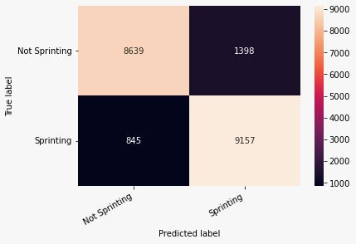
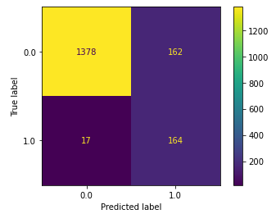
Neural network
THE PRESENT
Coding models: Decision tree classifier (90%) recall(50%)
definitions in the dataset
The options:
Neural networks
Repeat modelling and improving the dataset
decision tree
SGD
Decision tree
Notes:
The last few weeks we have been working on these activities. The best model we are using right now is decision tree this has an accuracy of about 90% precision 90% recall 50 %
But the further we worked with the models the more problems we faced. The main problem we needed to solve is that our dataset has no predefined answers.
To put it in simple terms, the sprints we need to detect are not predefined, we spoke about this with our problem owner. We have two ways to go about this problem.
Solution nr1. neural networks(call with martijn and jake to get more info) We can work around the issue by the use of neural networks. This works better on more complex patterns. at the moment our neural network uses a tensor of 3 features and works with intervals of 100th of a second, we want to increase this to 1 second so that we can look more globally instead of to a little specific point. at the moment our neural network is balanced not tuned, (see confusion matrix).
Solution nr2. repeat modeling decision tree and look at the false negatives to compute a more defined training dataset for the next run.
next to running the descision tree model we also started an
SGD model. this linear classifier works best because we have a very big dataset.

Slide 5
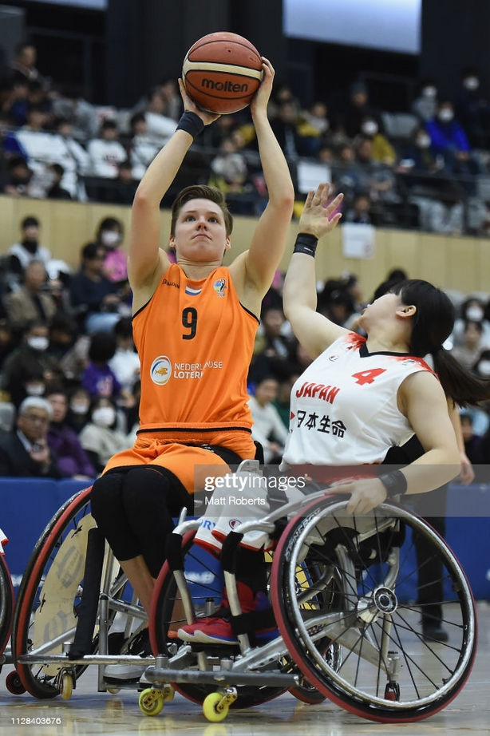
WHAT IS NEXT?
Image recognition
Convolutional neural network
Improving our current models
making statistical overview
Notes:
What is next?
With the use of image recognition, we are going to recognize graphs of sprints and rotations in order to detect these movements. but we are not sure about this solution yet
we want to create a convolutional network, this works almost the same as a neural network. the advantage of a convolutional neural network is that it prepares the data before using it.
to fully improve our models we need to keep defining our dataset better.
a better-defined dataset will improve our gridsearch function, this means our model will be more accurate.
after the model is finished, we will use statistics to categorize different sprints. [2sec, 2-5sec, 5< sec] this will give the coaches a better insight into the sprints.
We will evaluate the solutions we have right now. And find the best way to take the next step towards the end product.

